Slide 1

The Technology Value Stream: Lead Time, DevOps Ideals, and Value Stream Management
Brian Preston CSD380-A339 DevOps 6/1/2025

Slide 2
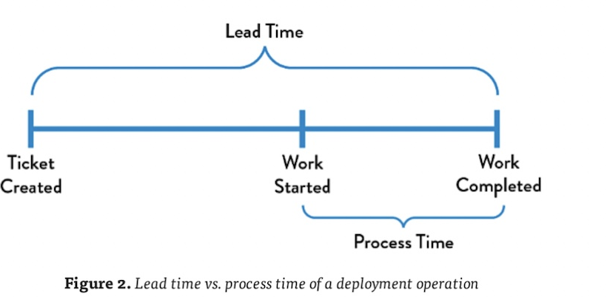
Lead Time: Starts when the customer request is made and ends when it is fulfilled. Processing Time: Starts only when work begins and ends when the work is completed. “Because lead time is what the customer experiences, we typically focus our process improvement attention there.” — The DevOps Handbook
Lead Time vs. Processing Time
Image from The DevOps Handbook, pg 38

Slide 3

The Common Scenario – Long Lead Times
Deployment Lead Times Requiring Months
These setups make everything slower — testing takes forever, nothing’s automated, and getting approvals feels like pulling teeth.
Many organizations work with tightly-coupled, “monolithic” applications.
These systems have:
Long testing cycles
Manual approvals
Scarce integration environments
Teams often do not have the right environments to test stuff properly, causing pile-ups
In the end, one small change can turn into a huge mess that takes weeks (or months) to fix.
Leads can sometimes to delays, broken code merges, and poor customer outcomes.
“Heroics are required at almost every stage of the value stream.” — The DevOps Handbook

Slide 4
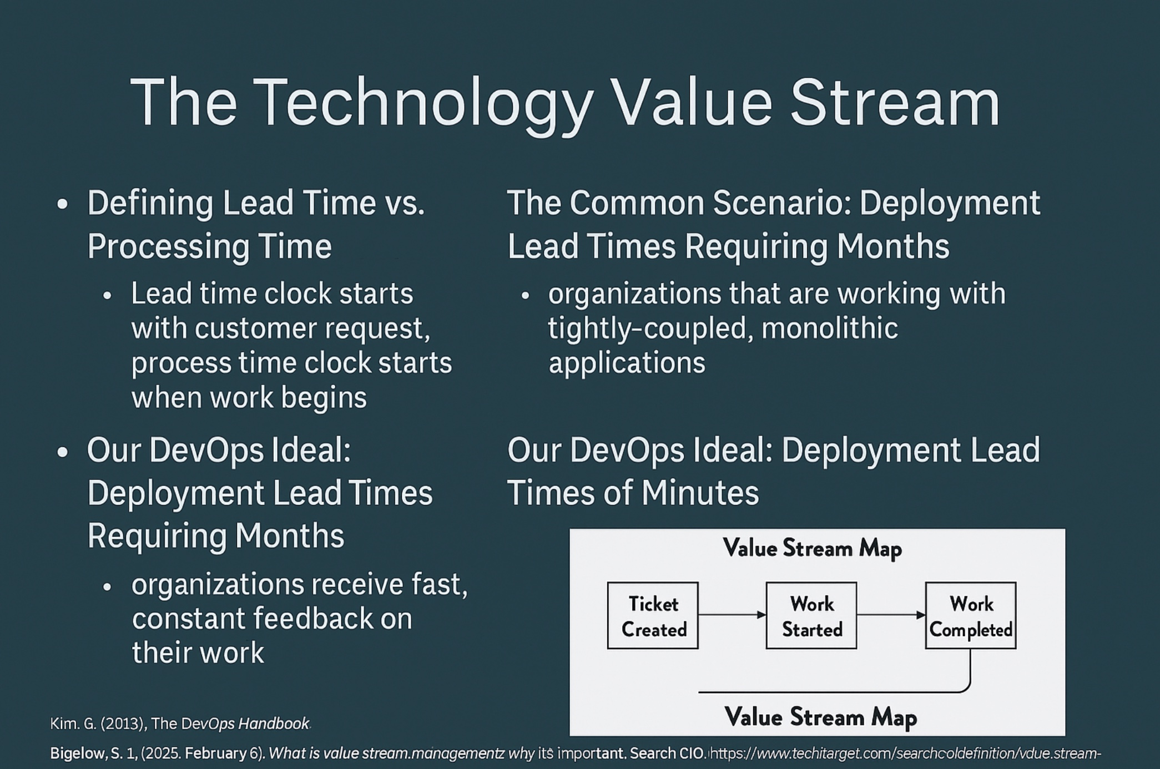
DevOps Ideal: Lead Times Measured in Minutes
In a perfect DevOps setup, changes move through the system in just minutes — sometimes hours — instead of dragging on for days or weeks.
Developers get quick, ongoing feedback so they can catch and fix issues early.
We keep updates small and manageable, which makes them easier to test and safer to release.
Since the system is built in smaller, more flexible parts, teams can work independently without breaking everything else.
This leads to smoother releases and fewer surprises in production.
(Visual Slide created by Brian Preston based on information from: Kim, G. (2013). The DevOps Handbook.)

Slide 5

What is Value Stream Management (VSM)?
VSM = tracking the flow of value through development and delivery.
Focus on:
Reducing waste
Aligning with business goals
Understanding what works (and what doesn’t)
“VSM helps a business oversee the complete end-to-end activity cycle and measure the success of that activity cycle.” — Bigelow, 2023

Slide 6

Why VSM Matters in DevOps
The Role of VSM in DevOps
Helps identify:
Bottlenecks
Resource limitations
Unprofitable activities
“By layering VSM on top of continuous deployment paradigms, a business can optimize workflows and drive automation.” — Bigelow, 2023
Enhances:
Delivery speed
Agility
Cross-team collaboration

Slide 7

Conclusion & References
DevOps works best when things move fast — short lead times and real-time feedback keep the flow strong.
The quicker we catch issues, the smoother everything runs.
Value Stream Management (VSM) helps us cut the clutter and stay focused on what actually brings value.
When we think in terms of value streams, we stop just "doing tasks" and start making a real impact.
References:
Kim, G. (2013). The DevOps Handbook.
Bigelow, S. J. (2023, February 6). What is value stream management? Search CIO. https://www.techtarget.com/searchcio/definition/value-stream-management

